Slide 1

Neuroscience and modelling in the Furl Lab
Nicholas Furl
19th June 2024
Centre for Decision Science

Slide 2

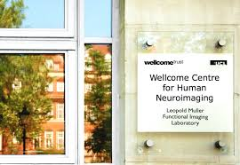



Biography
UT Dallas: Neural networks, SPECT, fMRI
FIL: Face perception, MRI, MEG
UCL CS: MEG multivariate methods
NIH: Face perception, decision making, modelling, MRI
MRC CBU: Face perception & MRI
RHUL: Furl lab

Slide 3
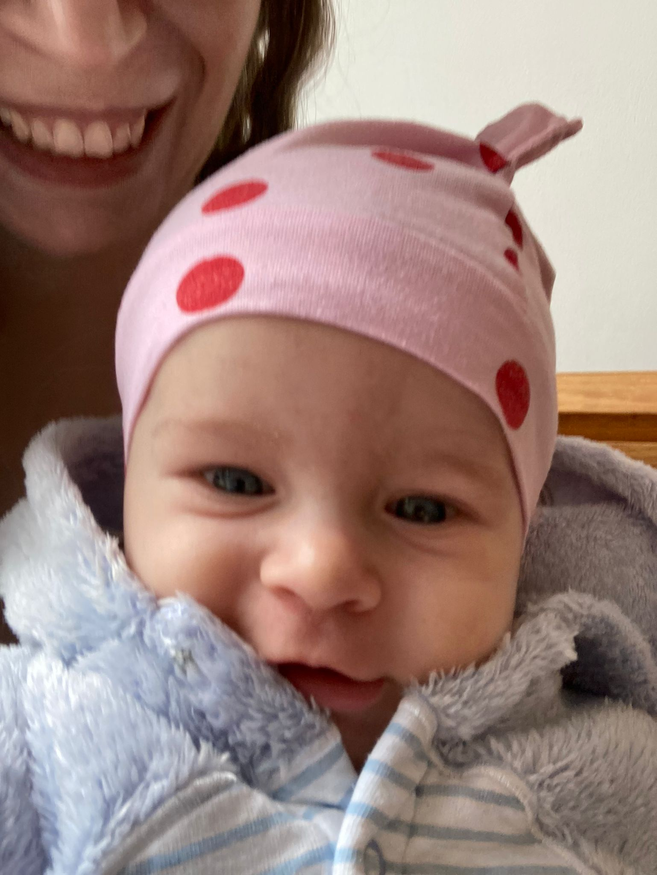
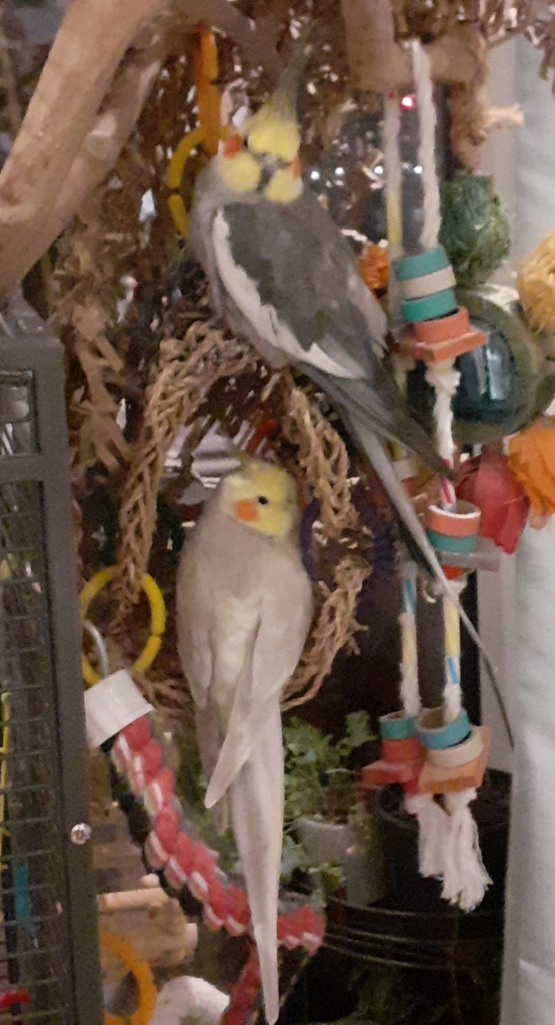
Biography
UT Dallas: Neural networks, SPECT, fMRI
FIL: Face perception, MRI, MEG
UCL CS: MEG multivariate methods
NIH: Face perception, decision making, modelling, MRI
MRC CBU: Face perception & MRI
RHUL: Furl lab
1

Slide 4
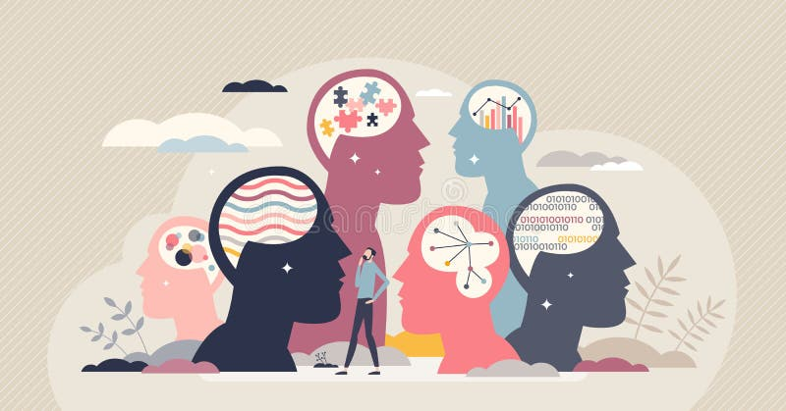
Individual differences:
What makes us different?

Slide 5

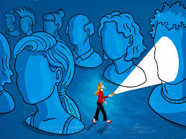
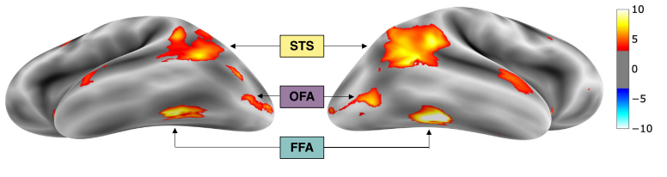
Developmental prosopagnosia:
Low facial recognition ability
What is the relationship?
Thanks to WashPo
The brain’s face perception network: Face-selective areas
2
Thome et al. 2022, N = 98

Slide 6
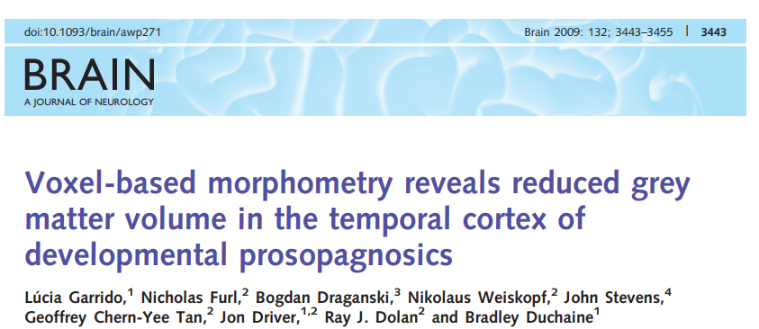
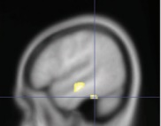
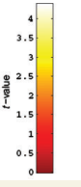
Face network shows altered characteristics in low recognisers
Structural MRI
Decreased grey matter volume

Slide 7
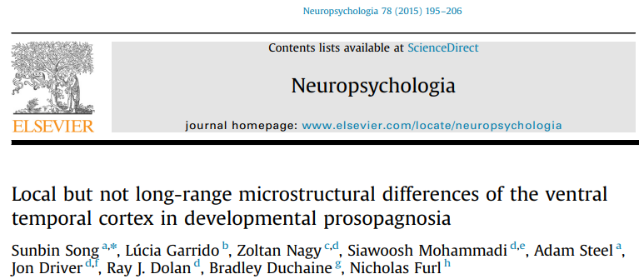
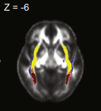
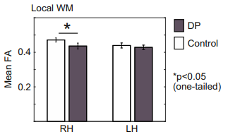
Face network shows altered characteristics in low recognisers
Structural MRI
Decreased grey matter volume
Diffusion tensor imaging
Decreased white matter

Slide 8
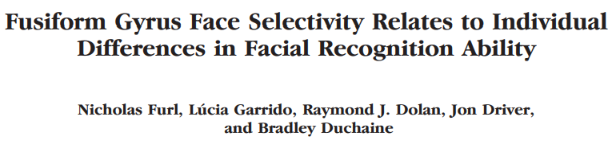
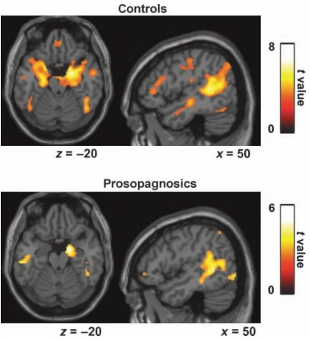
Face network shows altered characteristics in low recognisers
Structural MRI
Decreased grey matter volume
Diffusion tensor imaging
Decreased white matter
Functional MRI
Decreased face-selectivity
3

Slide 9
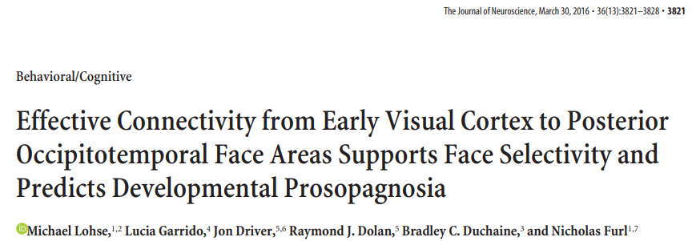
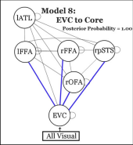
Face network shows altered characteristics in low recognisers
Structural MRI
Decreased grey matter volume
Diffusion tensor imaging
Decreased white matter
Functional MRI
Decreased connectivity
3

Slide 10

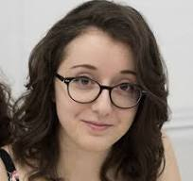
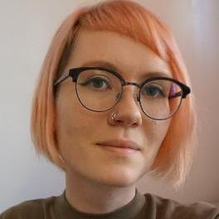
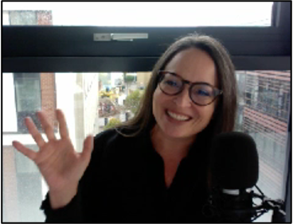
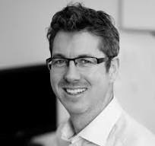
Superportraits
Gaia Giampietro
Thora Bjornsdottir
Laura Mickes
Ryan McKay

Slide 11
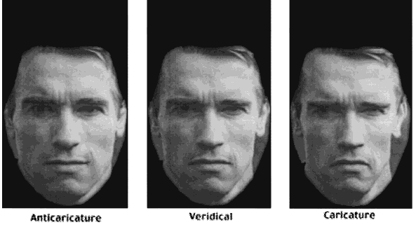
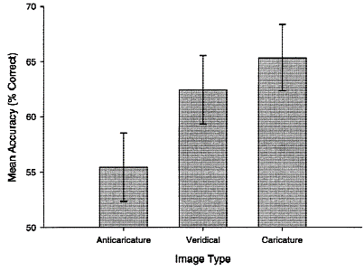
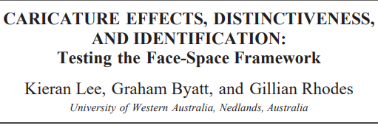
Superportraits
Caricatured test Swartzenegger better recognised
“More Swartzenegger” than learned veridical version

Slide 12
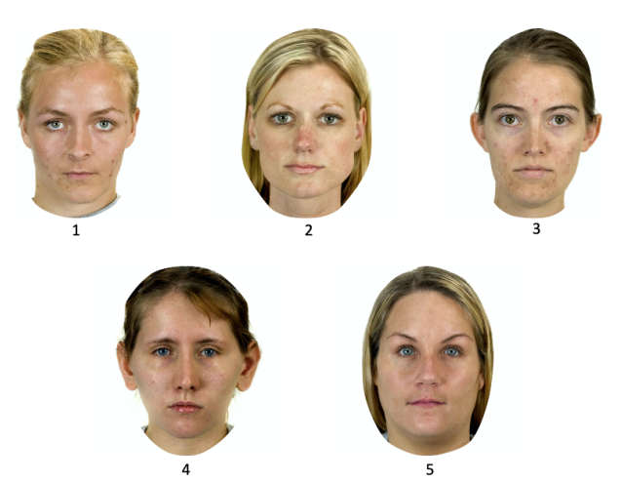
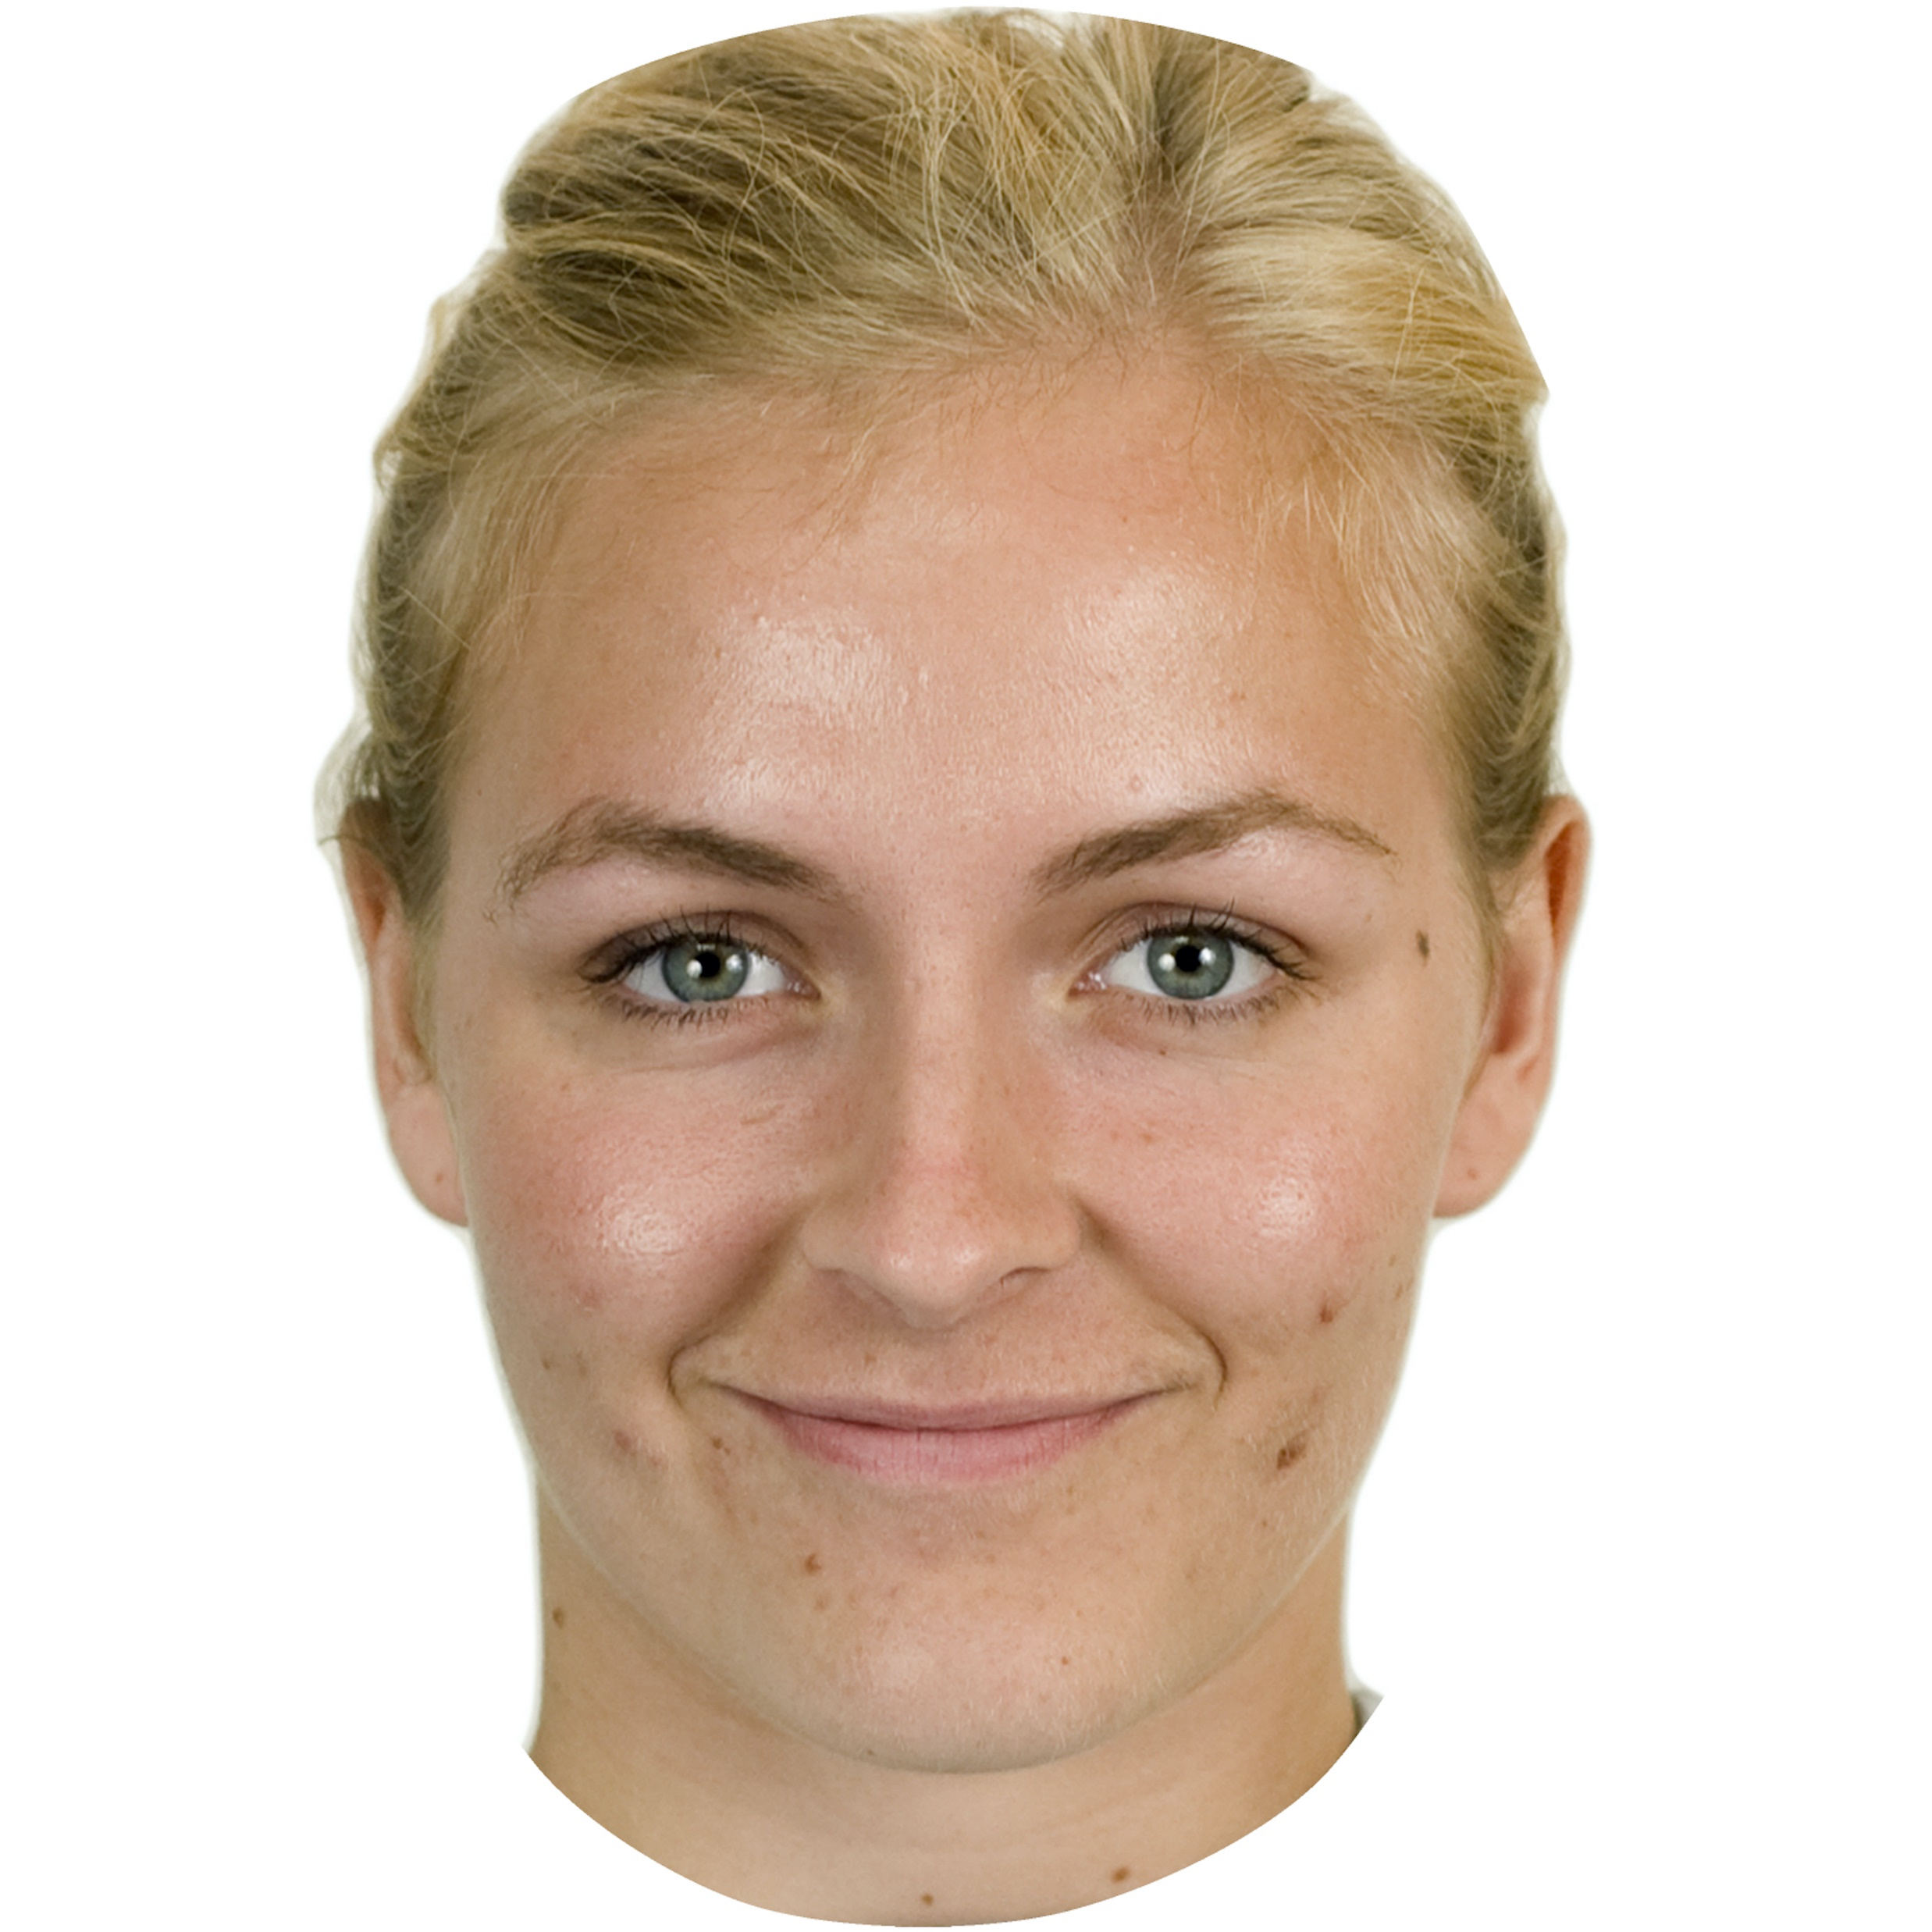
Can caricature aid identification of newly-learned faces in eyewitness lineups?
Perpetrator (“perp”)
Caricatured lineup, may / may not contain perp

Slide 13
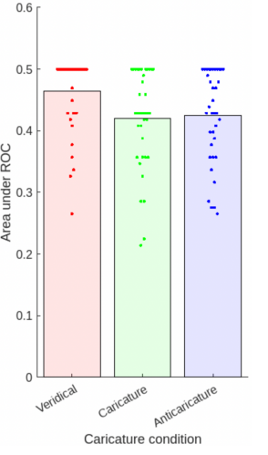
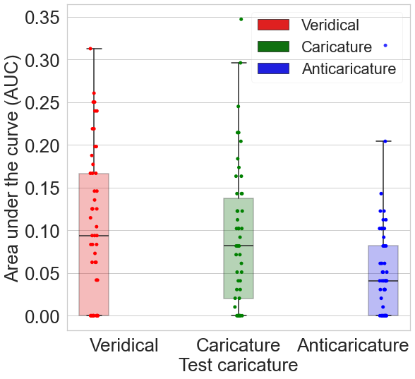
Veridical test faces most accurate, NOT caricatures
Deep convolutional neural network

Slide 14
Veridical test faces most accurate, NOT caricatures
Deep convolutional neural network
7

Slide 15

How do we explore our environment to gather evidence for beliefs?

Slide 16
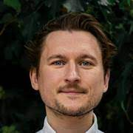

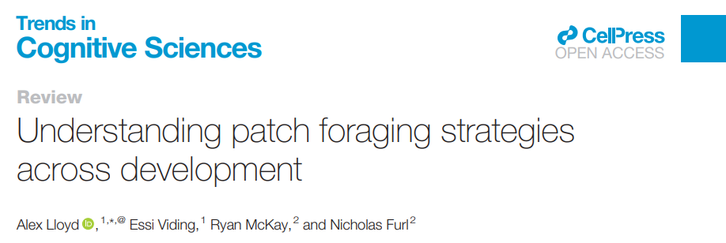
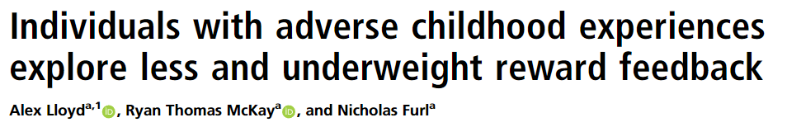
Research Question
Do adults with adverse childhood life experiences explore their environment differently?
Alex Lloyd
Ryan McKay

Slide 17
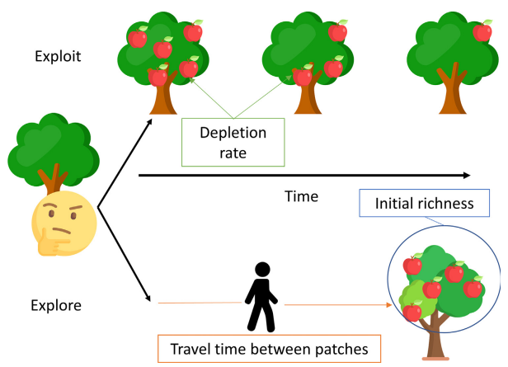
Research Question
Do adults with adverse childhood life experiences explore their environment differently?
Methods
Patch foraging explore/ exploit task

Slide 18
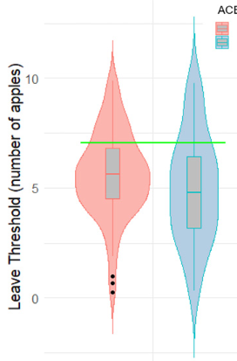
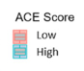
Research Question
Do adults with adverse childhood life experiences explore their environment differently?
Participants with ACEs ….
….. explore less
More exploration
Methods
Patch foraging explore/ exploit task
Leaving threshold
Optimal

Slide 19
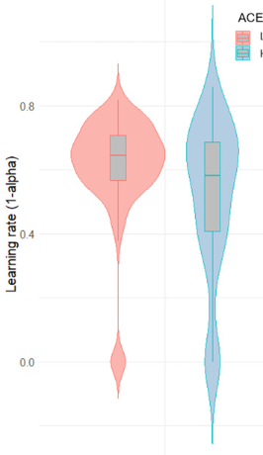
Research Question
Do adults with adverse childhood life experiences explore their environment differently?
Participants with ACEs ….
….. explore less
More exploration
Methods
Patch foraging explore/ exploit task
Leaving threshold
Mean value theorem + reinforcement learning model
Learning rate
Optimal
….. learn more slowly
Faster reward learning
10

Slide 20

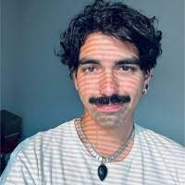
Research Question
Are people with subclinical delusion-like beliefs too influenced by evidence?
Francesco Scaramozzino
Ryan McKay

Slide 21
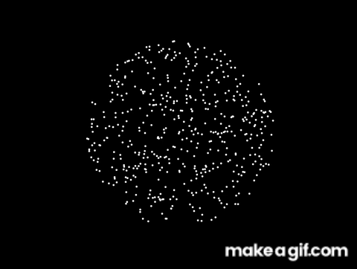
Research Question
Are people with subclinical delusion-like beliefs too influenced by evidence?
Methods
Coherent motion task

Slide 22
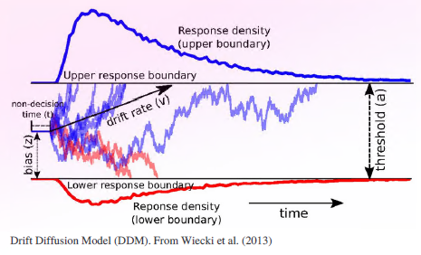
Research Question
Are people with subclinical delusion-like beliefs too influenced by evidence?
Methods
Coherent motion task
Drift diffusion model
Drift rate = how much does evidence influence belief?

Slide 23
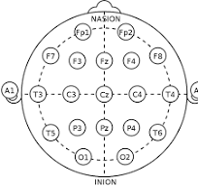
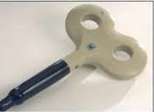
Research Question
Are people with subclinical delusion-like beliefs too influenced by evidence?
Methods
Coherent motion task
Drift diffusion model
Drift rate = how much does evidence influence belief?
Transcranial magnetic stimulation (TMS) to posterior parietal cortex

Slide 24
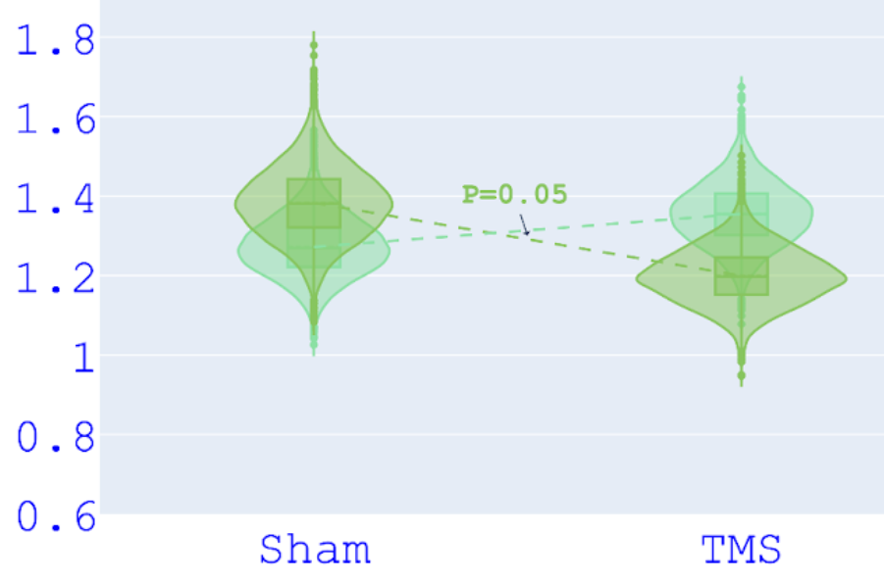
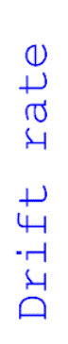
Research Question
Are people with subclinical delusion-like beliefs too influenced by evidence?
High delusion
Low delusion
Methods
Coherent motion task
Drift diffusion model
Drift rate = how much does evidence influence belief?
Transcranial magnetic stimulation (TMS) to posterior parietal cortex
Larger drift rate when high delusion
Parietal cortex has causal role
13:15

Slide 25

Research Question
How do people decide when to decide?
Methods
Sequential search for best price

Slide 26
Research Question
How do people decide when to decide?
Participants decide too early
Methods
Sequential search for best price
Optimal stopping models
Ideal observer (IO OV)

Slide 27
Research Question
How do people decide when to decide?
Participants decide too early
Too pessimistic about future options
Methods
Sequential search for best price
Optimal stopping models
Ideal observer (IO OV)
Theoretical models
Biased prior (BP OV)
17

Slide 28
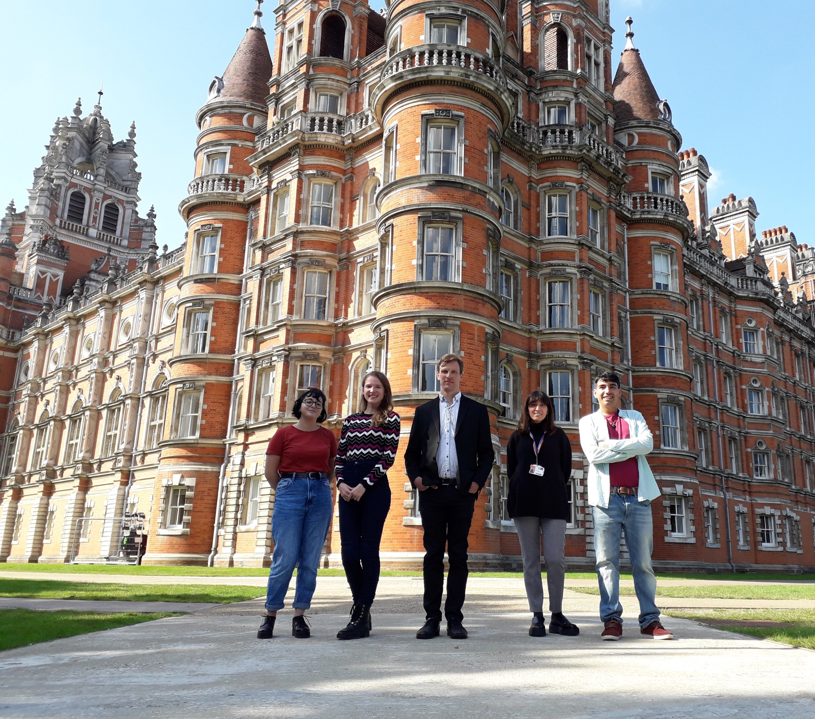
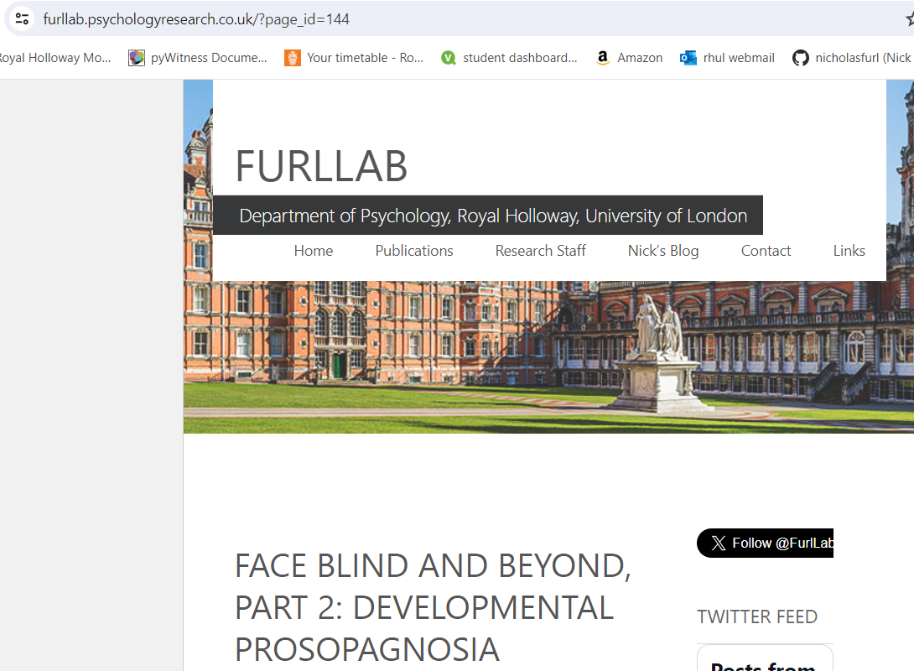

Thanks for coming
Check out my blog
furllab.psychologyresearch.co.uk
@furllab
nicholas.furl@rhul.ac.uk

Slide 29
Research Question
How do people decide when to decide?
Price
Methods
Search sequences for the best price

Slide 30
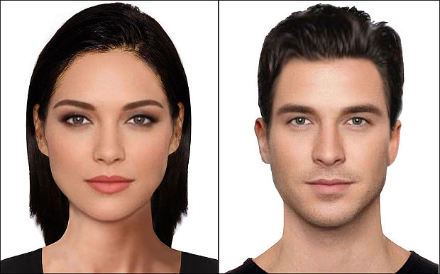
Research Question
How do people decide when to decide?
Price
Methods
Search sequences for the best price or most attractive face
Attractiveness

Slide 31
Research Question
How do people decide when to decide?
Price
Undersampling
Methods
Search sequences for the best price or most attractive face
Optimal stopping models
Ideal observer (IO) optimality
Attractiveness
Oversampling

Slide 32
Research Question
How do people decide when to decide?
Price
Undersampling
pessimistic
Methods
Search sequences for the best price or most attractive face
Optimal stopping models
Ideal observer (IO) optimality
Theoretical models
Cost to sample (CS)
Cut off (CO)
Biased prior (BP)
Attractiveness
Oversampling
Sampling costly & optimistic

Slide 33
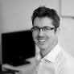

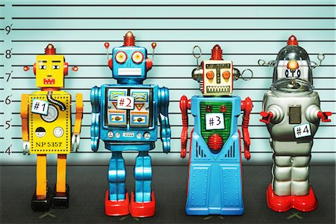
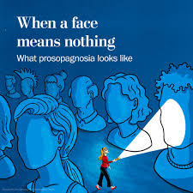
Future plans
NOMIS grant with Ryan McKay
How does social identity motivate poorly-evidenced beliefs (conspiracies, anti-climate, anti-vax, etc)?
Sabbatical at King’s College London with Sukhi Shergill
Modelling neuroscience of beliefs in schizophrenia
Forensic applications of face recognition in humans and machines
Normal variability in face recognition ability
17:45

